Slide 1
External Memory Interface
Implementation Using 28nm FPGAs
Technology Roadshow 2011

Slide 2
Complete Memory Solutions
External Memory IP MegaCore® Functions
Support for common memory standards (DDR 1/2/3, QDR, RLDRAM)
Low latency high performance
Included in the Free IP Base Suite
Advanced FPGA
Architecture
Dedicated circuits to enable higher performance
Best in class signal integrity
Software Support
Automatic Generated Constraints
System Level Timing Analysis
Spice and IBIS Simulation Models
Development Kits &
Hardware Reference Platforms
Support Collateral
Device Handbook
Application Notes
Reference designs
Board Design Guidelines

Slide 3
Altera Memory Interface Leadership @28nm
Highest Frequency
  1066 MHz (2132 Mbps)
Highest Bandwidth
  921 Gbps(Based on six 72bit interfaces @ 2132Mbps, in Stratix V)
Lowest Latency
  7 - 15 clock cycles at half rate
Highest Efficiency
  Up to 36% efficiency for 50/50 read/write with random access
Best Design Options
  Hard controller options for ease of implementation
  Soft controller options for maximum flexibility
  Ubiquitous high-performance IO

Slide 4
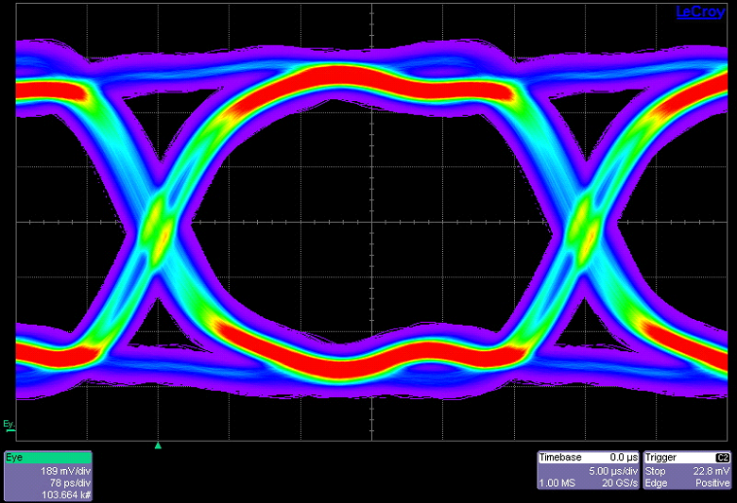
Stratix V DDR3 1067MHz Eye-Diagram
1066MHz DDR3 Performance on any pin

Slide 5
High-end FPGA Memory Solution
Highest Available Frequency & Bandwidth
 | ALTERA Stratix V | Nearest Competitor
Max. Frequency | 1066 MHz | 933 MHz
Max. Interface Bandwidth | 921.02 Gbps | 671.76 Gbps
Controller Efficiency (50% Random Addresses, 50% RW turnaround) | 34.13% | 29.12%
Memory Bandwidth = Interface Bandwidth X Efficiency | 314.34 Gbps | 195.61 Gbps
61% more memory bandwidth for X72 DDR3

Slide 6
Altera UniPHY 11.0:
Lowest Latency PHY

Slide 7
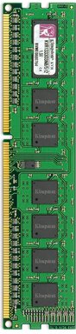
Memory Interface Layers
Re-architected Memory PHY, Controller, and Multi Ported Front End
  PHY – UniPHY
  Controller – High Performance Memory Controller II (HPMC II) version 11.0
  Multi Ported Front End- Hardened for Arria V/Cyclone V
Re-architecture Goals:
  Improve ease-of-use
  → faster learning, ramp up, and use of the core
  Maximize performance
  → higher Fmax, robust timing closure, lower latency, higher efficiency
  Improve quality
  → get you more features, faster time to market at the highest quality
FPGA
Front End
Controller
PHY
Address / Command
I/O Buffers
DDIO
DDIO
Avalon
Command Queues
Arbiter
Clocking
Avalon-ST/MM AXI
Input Adaptor
cmd6
DDIO
cmd7
cmd5
cmd4
Command
Queue
Command
Ordering
Logic
Command Queue
TBP Command Pool
Data Path
Avalon
Avalon
cmd1
AFI
PCB
Arbiter
Avalon-ST/MM AXI
Input Adaptor
DDR Command Generator
(Burst Adaptor)
cmd3
Scheduler/Arbitrator
DDIO
cmd7
cmd6
cmd5
Avalon-ST/MM AXI
Input Adaptor
cmd6
cmd4
cmd7
cmd5
cmd4
cmd2
FIFO
cmd0
Avalon
Avalon-ST/MM AXI
Input Adaptor
cmd6
Calibration
Sequencer
cmd7
cmd5
cmd4
Notes:
PHY
Physical interface between the FPGA and DDR3 devices
Handles I/O timing requirements imposed by memory device
Implemented in FPGA periphery using dedicated circuits
IOE registers, DQS clock trees, DLL, PLL, OCT, delay chains, etc.
Controller
Interfaces between the PHY and user logic using Avalon-MM
Handles DRAM bank management and command sequence
Implemented in FPGA core fabric
Front-end
Shares memory interface bandwidth between multiple masters
Arbitration handled by SOPC/Qsys or custom MPFE component

Slide 8
UniPHY Architecture (Stratix V)
Legacy
Stratix V
Stratix III
DLL
PLL
I/O Structure
I/O Structure
I/O Structure
config
PLL
Re
-
config
I/O Structure
Re
-
Auto Cal
Re
-
config
PLL
Re
-
config
Calibration
Sequencer
PLL
Calibration
Sequencer
Mimic path
Clock gen
Auto Cal
Clock Gen
DLL
Clock gen
Mimic path
Clock Gen
Mimic Path
Altmemphy
Memory
Memory
Controller
Memory
Memory
UniPHY
Memory
DSQ I/O
DLL
DLL
DQS
Path
Altmemphy
Memory
Controller
block
ALTMEMPHY/UniPHY
Write path
DSQ I/O
Write Path
DQS
Path
DQ I/O
DQ I/O
block
DQ I/O
block
FIFO
Read Path
Write path
Read Path
DQ I/O
Write Path
DQ I/O
DQ I/O
I/O
I/O
I/O
Address/cmd path
block
Address/cmd Path
Block
Block
Read Path
block
Read Path
I/O
I/O
I/O
Address/cmd path
Block
Address/cmd Path
block
Hard
Soft
Hardened read/write path ⇨
Built-in timing closure at 1066 MHz
8
Notes:
8
Enhanced features
Lower read latency ~ half that of ALTMEMPHY
PLL/DLL instantiated at top level to support sharing across multiple interfaces
More DIMM and rank configurations
Auto calibration
Higher Speeds
Stratix V will go up to 1066Mhz
Improve ease of use
UniPHY available as cleartext (unencrypted)
Nios processor-based calibration sequencer for easier debug
Convenient application of timing and pin constraints
Improved testbench/driver for easier debug/performance monitoring
Flexible timing models – provide transparency and higher accuracy
Available as soft controller for SV and hardcontroller for AV and CV
Entire PHY not hardened for max flexibility in high-end designs

Slide 9
UniPHY Architecture (Arria V and Cyclone V)
Legacy
Arria V/ Cyclone V
Stratix III
DLL
PLL
I/O Structure
I/O Structure
I/O Structure
config
PLL
Re
-
config
I/O Structure
Re
-
Auto Cal
Re
-
config
PLL
Re-config
Calibration
Sequencer
PLL
Calibration
Sequencer
Mimic path
Clock gen
Auto Cal
Clock Gen
DLL
Clock gen
Mimic path
Clock Gen
Mimic Path
Altmemphy
Memory
Memory
Controller
Memory
Memory
UniPHY
Memory
DSQ I/O
DLL
DLL
DQS
Path
Altmemphy
Memory
Controller
block
ALTMEMPHY/UniPHY
Write path
DSQ I/O
Write Path
DQS
Path
DQ I/O
DQ I/O
block
DQ I/O
block
FIFO
Read Path
Write path
Read Path
DQ I/O
Write Path
DQ I/O
DQ I/O
I/O
I/O
I/O
Address/cmd path
block
Address/cmd Path
Block
Block
Read Path
block
Read Path
I/O
I/O
I/O
Address/cmd path
Block
Address/cmd Path
block
Hard
Soft
Entire PHY hardened read/write path ⇨
Built-in timing closure
Entire UniPHY hardened for Arria V and Cyclone V
9
Notes:
9
Enhanced features
Lower read latency ~ half that of ALTMEMPHY
PLL/DLL instantiated at top level to support sharing across multiple interfaces
More DIMM and rank configurations
Auto calibration
Higher Speeds
Stratix V will go up to 800Mhz
Improve ease of use
UniPHY available as cleartext (unencrypted)
Nios processor-based calibration sequencer for easier debug
Convenient application of timing and pin constraints
Improved testbench/driver for easier debug/performance monitoring
Flexible timing models – provide transparency and higher accuracy
Available as soft controller for SV and hardcontroller for AV and CV
Entire PHY hardened for highest ease-of-use in timing closure for midrange and low-cost designs

Slide 10
New Quarter Rate with 2T Command Timing
Notes:
Timing diagram showing how 2 DRAM commands are issued per quarter rate controller clocks with 2T memory timing – 1 command for every 2 memory clocks

Slide 11
Latency of the new UniPHY in 11.0
Controller Rate | Latency Type | Latency (memory clock cycles)
 |  | Controller | PHY | Total
Half | Write command | 12 | 3 | 15
 | Read command | 10 | 3 | 13
 | Read data | 0 | 7 | 7
Quarter | Write command | 20 | 9 | 29
 | Read command | 20 | 9 | 29
 | Read data | 0 | 11 | 11

Slide 12
Altera: Industry’s Highest Efficiency Memory Interfaces

Slide 13
Altera Memory Controller Solutions
DDR1/2/3 SDRAM High Performance Memory Controller II (HPMC II)
  2x the controller efficiency of HPMC I
  More features, increased throughput
Features | HP Memory Controller II | HP Memory Controller
MegaCore function in Quartus II software 9.1 | ☑ | ☑
Support 1066MHz DDR3 memory | ☑ | ☑
ECC with sub-word write | ☑ | ☑
Power Management | ☑ | ☑
5 cycle controller latency (6 w/ ECC) – same on both | ☑ | ☑
Advanced bank management w/ command look-ahead | ☑
Flexible system interface | ☑
Run time programmable | ☑
Multicast writes | ☑
QDR II / II+ and RLDRAM II Controllers
  Available as MegaCore functions in Quartus II software 11.1 with UniPHY

Slide 14
HPMC II Provides Highest DDR3 Efficiency
(Hard or Soft Controller)
28% More
Efficient
17% More
Efficient
14% More
Efficient
Altera
DDR3 Memory Efficiency
Nearest Competitor
Best in class memory controller efficiency!

Slide 15
High Performance Memory Controller Architecture
Local Interface
Write Data
Read Data
DRAM Command Generator
Reorder
Write
Buffer
ECC Detect
& Correct
Reorder
Read
Buffer
Timer Bank Pool
(TBP)
…
TBP
TBP
TBP
ECC
Encode
Control & Status
CMD Packet
Rank Timer
Row Arbiter / Column Arbiter
1T/2T/4T Addr/CMD Decoder
AFI PHY Interface
Notes:
SDRAM High Performance Controller II MegaCore
Support for industry-standard DDR2 and DDR3 SDRAM devices and modules
Support for low power mobile-DDR and LPDDR2
Interfaces compatible with current memory controller
Performance:
Up to 800MHz memory speed at quarter rate (200MHz controller clock)
1-T and 2-T command timing maintain command channel bandwidth
50% higher random access efficiency with data reordering (out of order transactions)
Command look-ahead bank management (out of order SDRAM commands)
Low latency operation with 5 cycles from user command to PHY interface
Flexibility:
Run time configuration of memory timing and configuration parameters
Well documented clear-text RTL for ease-of-use
Advanced Features:
ECC with sub-word writes
Power down and Self-refresh support
Optimized architecture further reduces controller area

Slide 16


High Performance Memory Controller II
High Efficiency Data Reordering
50% higher efficiency for random transactions
User transactions may be serviced out of order
  Minimize bus turnaround time by grouping read and write transactions
  Minimize tRC impact by reordering transactions with bank conflicts
Read data returned in the same order as the requests
Notes:
Two ways to do data reordering.
You can group reads and writes to avoid bus turnaround latency. (It takes longer to do a read- write – read transaction then 3 consecutive reads).
You can order commands based on banks so you do not incur a latency hit as you switch banks

Slide 17
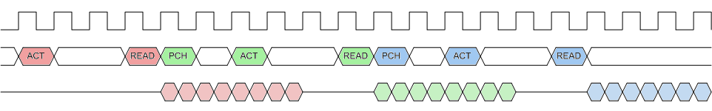
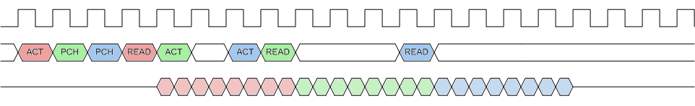
Advanced Bank Management
Look-ahead bank management
  Efficient bank interleaving support
  Issue activate and precharge commands early
  Use auto-precharge where possible
  In-order read/writes
Per access open or close page policy
  Read/write accesses with auto-precharge
  Automatic cancellation of auto-precharge on page hits
No Look Ahead
Not Efficient!!
Idle cmd bus
With Look Ahead Bank Management
Use of idle cycles for
bank-management
Command | Address | Condition
Read | Bank 0 | Activate required
Read | Bank 1 | Precharge required
Read | Bank 2 | Precharge required

Slide 18
Flexible User Interface
Optimized for memory controller traffic with high initial access latency
  Separate addr/cmd and data phases
  multiple outstanding addresses
Supports up to 6 x64/x32 ports
  Data ports may be combined to form wider and bidirectional interfaces
  Asynchronous or pseudo-synchronous operation
  Uni-directional interface support enables low-cost DMA or master mode data transfers
Avalon-MM and AXI support
Full Qsys support
Avalon MM / AXI Master
Memory Interface
External Memory
Memory Controller
PHY
Avalon MM / AXI Interface
Command &
Timing Control
AFI Interface
AFI Interface
cmd / addr
IO Structure
Read
Data path
Read / write
Write
Data path
Calibration
Write
acknowledge
User Control
Config & Status Reg
Config & Status Reg
Avalon ST /
AXI ST
Avalon MM /
AXI
Avalon MM /
AXI
User Control
CSR Master

Slide 19
User Ports
Separate address/command ports, read data ports and write data ports
  6 address/command ports
  4 x64/x32bit read data ports
  4 x64/x32bit write data ports
2 or 4 data ports may be combined to form x128bit data ports
Read and write data ports may be combined to form bi-directional data ports
Configurable up to 6 uni-directional or 4 bi-directional Avalon-MM user ports
  Each x64 interface may be configured to support x64 or x32 devices
Each user memory port may be operated
  Asynchronous to the memory clock, or
  Pseudo-synchronous to the memory clock at 1/1, 1/2, 1/4 or 1/8 memory clock

Slide 20
Other Advanced Features
Run time programmable
  Timing parameters, configurations (row, col, bank, cs) and mode register settings
ECC with sub-word writes
  32+8 and 64+8 bits
Multicast write to mitigate effects of tRC
  Write to multiple-ranks, read from any open rank
Refresh timing control
  Programmable periodic refresh
  User requested auto-refresh
Power Management
  User requested self-refresh
  Automatic entry / exit power down mode

Slide 21
Altera: Best Memory Interface Design Options

Slide 22
Hard and Soft Controller Options
Stratix V only has soft memory controllers
  Goal was to support the most flexibility
    Based on location
    Based on bus width (8,16,32,64,128, etc…)
Arria V and Cyclone V
  Goal was to support ease of implementation
    Hard controller has fixed location but is
      Maximum of 64 bits
      Timing closed and Verified
      Out of the box experience
    Limited number of controllers
  Soft controllers are also supported to add additional flexibility

Slide 23
Multi Ported Front End

Slide 24
Multi-Port Memory Controller Architecture
Multi-Port
Front-End
Data Reordering Single Port
Controller
Notes:
Reordering single port memory controller based on Quartus II 11.0 SDRAM Controller II

Slide 25
Multi-Port Scheduler
Two levels of scheduling
  Per port scheduling – Multi-Port Front-End (MPFE)
  Per DRAM Burst scheduling – Single port controller
Supports up to 6 user ports
Per Port Scheduling (MPFE)
  Selects the user transaction to service next between the active ports
  Each user transaction is divided into a series of individually scheduled DRAM bursts
  Deficit Round Robin arbitration (DRR)
    Per port absolute priority and weight – maybe updated dynamically
    Allows temporary over and under service – smooth out memory traffic
  Port priority is increased if max latency is exceeded to limit worst case latency
  Port may be configured to win multiple bursts to keep DRAM page open
  Port may provide hint to keep DRAM page open
Per Port User Scheduling
  Per transaction weight

Slide 26
Per Port Scheduling Details
Schedule on DRAM bursts to ensure that a long transaction
  Does not lock other transactions out of servicing, or
  Does not cause large latencies for high priority ports
Schedule based on two independent components:
  Absolute priority
    Individual ports are serviced as soon as they have traffic and they are of higher priority
    Allows a port to get a fixed priority above or below others
    8 programmable per port priority levels
  Relative priority (weight)
    Controls scheduling between ports with the same absolute priority
    5 bit programmable per port relative priority
    Deficit Round Robin arbitration (DDR)
Scheduling cycle:
  Write: when enough data for a DRAM burst is received
  Read: when sufficient internal read buffer memory is available to hold the DRAM return data
Notes:
Deep technical details for the few that need to know.

Slide 27
Deficit Round Robin Arbitration (DRR)
Selects between ports with the same absolute priority
Allows temporary over- or under-servicing
Provides a better match between user data rate and DRAM data rate
Port priority and DRR weight may be updated dynamically without stopping or altering memory transaction flow.
Each port in a DRR has a running weight
On each scheduling cycle:
  Running weight for ports at the highest absolute priority level are updated
  The user configured weight is added to the per port running weight
  The amount of traffic serviced is subtracted from the per port running weight
  The port with the highest running weight wins the arbitration
Notes:
Deep technical details for the few that need to know.
The scheduler can take up to ten cycles to process a weight update.

Slide 28
Summary: Re-designed Memory Architecture
Higher system performance
  ~Half latency of current solution
  ~2x efficiency of current solution (controller benefit)
Higher IP quality
  Extensive verification
Earlier IP availability
  Flexible timing models
Easier design flow
  Easy to use GUI panels
Improved documentation
  Follows typical system design flow
Faster, Better, Easier!

Slide 29
Automatic Calibration
Capture Calibration (De-skew)
Before de-skew - small valid capture window
After de-skew - maximize valid capture window
Benefit: Reduce skew between data group ⇨ More capture margin
Resync Calibration
Benefit: Accurate strobe placement ⇨ More resync margin
VT Compensation
Voltage and temperature tracking
Data shifts due to VT variations
Benefit: Dynamic phase adjustment to match shifting data valid window ⇨ Robust over VT
Notes:
Capture Margin from memory to device with first section
From memory domain to system domain via Resync Margin via Calibration
Maintain the margin over time with VT compensation.

Slide 30
Example Design, Driver, and Testbench
Example Testbench:
Integrates memory models with example design and driver
Example Design:
Generated with IP
Matches user parameterization
Includes PHY, Controller, Driver
Example Driver:
Included in example design
Synthesizable for boards and simulation
Hooks for user-specified patterns
Available as an SOPC Builder component
Can be used as BIST engine
PHY
Controller
Driver
Memory
Avalon
AFI
Memory Model
Pass/Fail
Example Design
Example Testbench
Initialize
Sequential
addresses
Individual
reads/writes
Random
addresses
Block
reads/writes
Sequential/
Random
addresses
User defined
stages (optional)
User defined
addresses
(optional)
Pass
Fail
Example Driver
Notes:
Packaged well with test bench. Drive we leave hooks for users to insert their own patterns for debug, performance monitoring, etc.

Slide 31
Thank You

